Slide 1
Introduction to .NET and C#
Building blocks of .NET and your first C# application

Slide 2
What is .NET Framework

Slide 3
What is .NET Framework
Environment for execution of .NET programs (CLR)
Powerful library of classes (FCL)
Programming model
Common execution engine for many programming languages
C#
Visual Basic .NET
Managed C++
... and many others

Slide 4
Building blocks of .NET
Inside .NET framework
Languages
C#
VB.NET
Managed C++
F#
Python
Delphi
…
ASP.NET
MVC, Web Forms, Web API, SignalR
WPF & XAML
Windows Store Apps
Windows Forms
Silverlight,
WP7 / WP8
FCL
WCF, WWF (Communication / Workflow Tier)
ADO.NET, Entity Framework, LINQ, XML (Data Tier)
Base Class Library (BCL) – I/O, Threading, Collections, Strings, …
CLR
Common Language Runtime (CLR) + DLR (for Dynamic Languages)
OS
Operating System (Windows / Linux)

Slide 5
The hart of .NET framework
Common Language Runtime (CLR)
Managed execution environment (virtual machine)
Executes .NET applications
Controls the execution process
Automatic memory management (garbage collection)
Programming languages integration
Multiple versions support for assemblies
Integrated type safety and security

Slide 6

Framework Class Library (FCL)
Provides basic classes for developers:
Console applications
Web applications and web services
XAML, WPF, Silverlight rich-media applications
Windows Forms and WPF GUI applications
Windows Store applications
Database applications
Applications for mobile devices

Slide 7
C#
Your first .NET application

Slide 8

What is C#
C# is a modern programming language
A syntax that allows to give instructions to the computer
C# features:
Extremely powerful
Easy to learn
Easy to read and understand
Object-oriented
Functional programming features

Slide 9

Your first C# application
using System;
class HelloWorld
{
static void Main()
{
Console.WriteLine("Hello, World");
}
}

Slide 10
Include the standard .NET namespace "System"
Define a class called "HelloWorld"
using System;
class HelloWorld
{
static void Main()
{
Console.WriteLine("Hello, World");
}
}
Define the Main() method – the program entry point
Print a text on the console by calling the method "WriteLine" of the class "Console"

Slide 11
Class names should use PascalCase and start with a CAPITAL letter.
using System;
class HelloWorld
{
static void Main()
{
Console.WriteLine("Hello, C#");
}
}
The { symbol should be alone on a new line.
The } symbol should be under the corresponding {.
The block after the { symbol should be indented by a TAB.

Slide 12

Visual Studio
Visual Studio – Integrated Development Environment (IDE)
Development tool that helps us to:
Write code
Design user interface
Compile code
Execute / test / debug applications
Browse the help
Manage project's files

Slide 13

Solutions and projects
A Visual Studio blank solution
Solution with no projects in it
Projects to be added later
Why we need a blank solution in Visual Studio?
First create a blank solution for your homework
Then create a project for each assignment from the homework

Slide 14
Your first C# application
Live demo

Slide 15
MSDN Library
The documentation you need

Slide 16
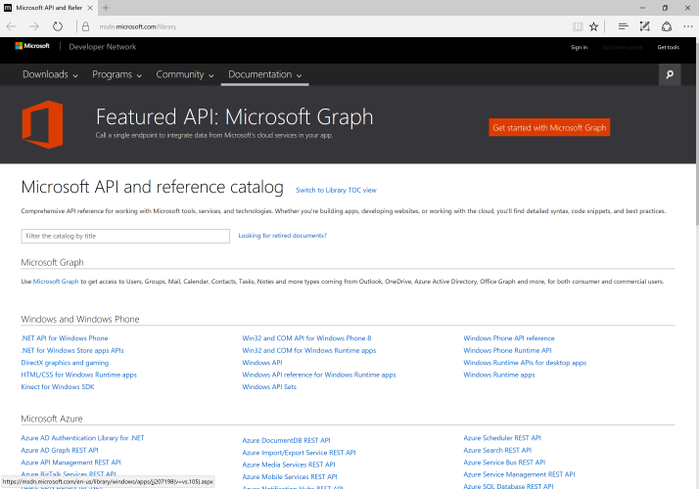
MSDN Library
Complete documentation of all classes and their functionality
With descriptions of all methods, properties, events, etc.
With code examples
For all Microsoft technologies
Related articles
Library of samples
MSDN Library is available at msdn.microsoft.com/library

Slide 17

Any questions

